Slide 1
Musculoskeletal Model of Fingers to Enable Design of Prosthetic Gloves
By Shashank Swaminathan

Slide 2
Overall Proposal
Premise:
By thoroughly understanding the relationship between muscle actuation and grasping characteristics of the hand, it is possible to improve design and control of prosthetic assist technologies.
Question: Can mathematical model based analysis be used to investigate the musculoskeletal dynamics of the hand?

Slide 3
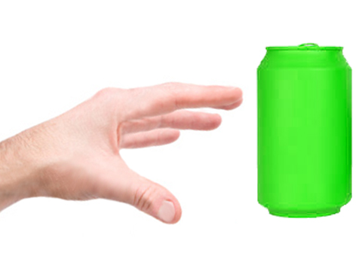
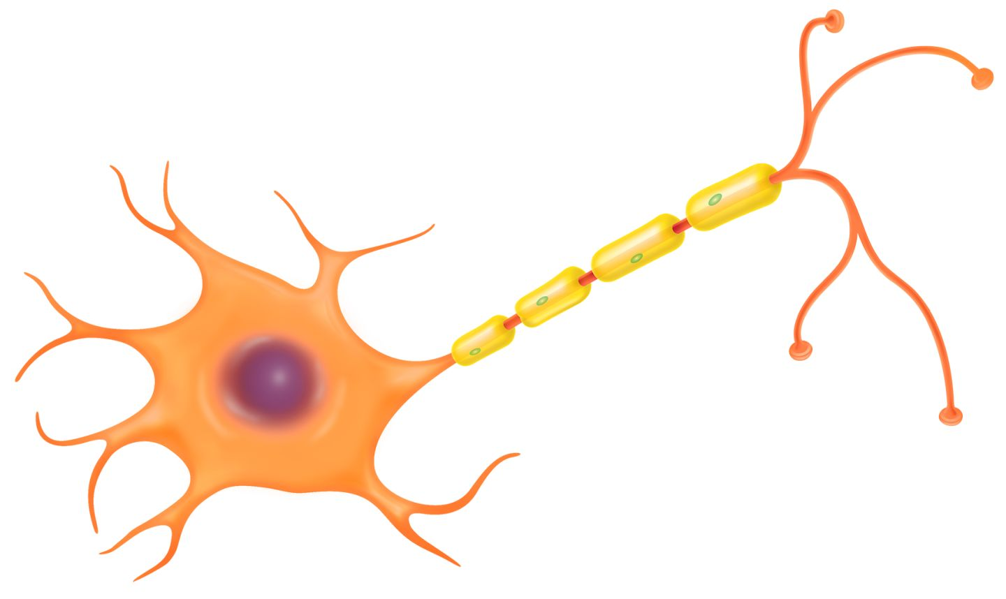
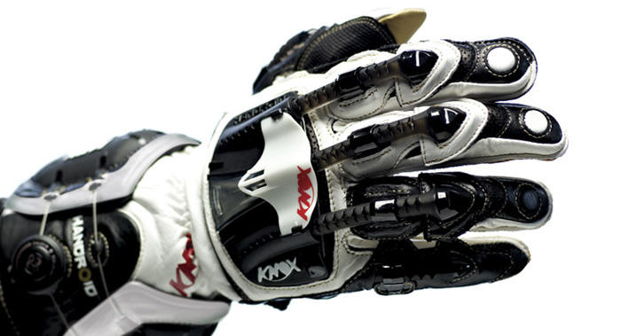
Design Question
Physiology
θ
Stiffness
Load
Muscle Activation Percentages
Brace Operation
?
θ
Stiffness
Load
Muscle Activation Percentages

Slide 4
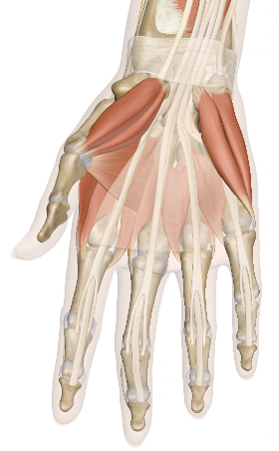

Functional Unit Component Model
Scope of Project
Bone 2
θ_{desired}
τ, dτ/dθ
Anterior Muscle
Posterior Muscle
F_{A}
F_{P}
Bone 1
Goal

Slide 5
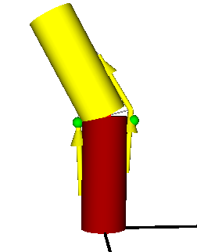
Design of the Muscle-Joint Component
Upper Bone
Posterior Muscle
Muscle Threading Points
Restraining Revolute Joint
Anterior Muscle
Lower Bone

Slide 6
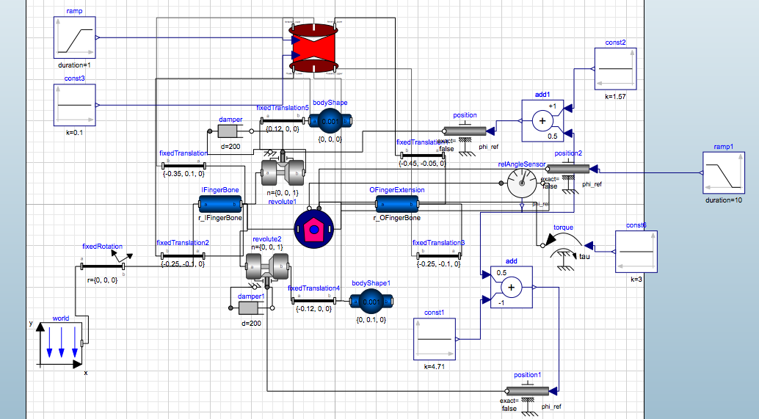
Bone-Muscle Joint Model Implementation
Above is the model of a single bone-muscle-joint system
Modelica was used to represent the physical equations
SystemModeler was the simulation tool
The MultiBody library in SystemModeler was used for rigid-body analysis

Slide 7
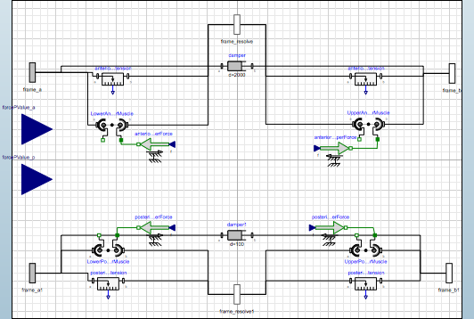
Bone-Muscle Joint Model Implementation
Above is the muscle model

Slide 8
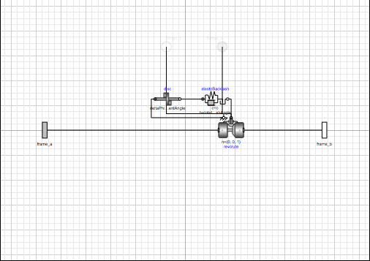
Bone-Muscle Joint Model Implementation
Above is the restraining revolute joint component

Slide 9
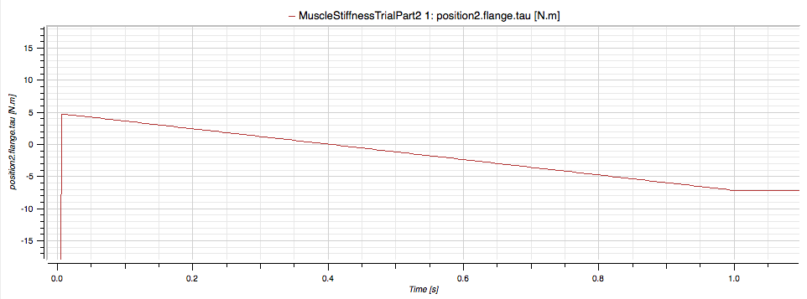
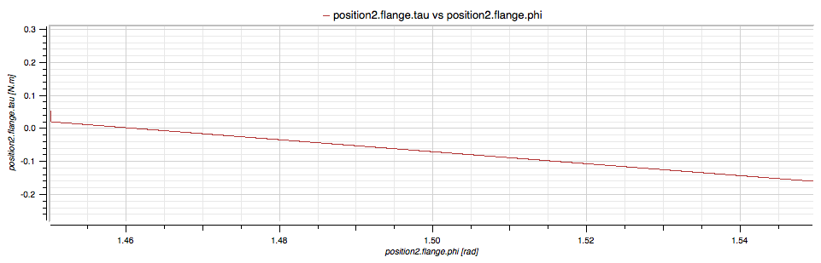
Experiment Procedure
Set value for F_{P}
Set values for θ and τ
Ramp values for F_{A}, and simulate
Determine value for F_{A} (figure 1)
Set determined value for F_{A}
Perturb value of θ
Simulate and graph τ vs. θ
Determine from slope dτ/dθ (figure 2)
This process is automated using Mathematica
Figure 1
Figure 2

Slide 10
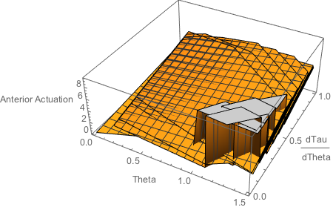
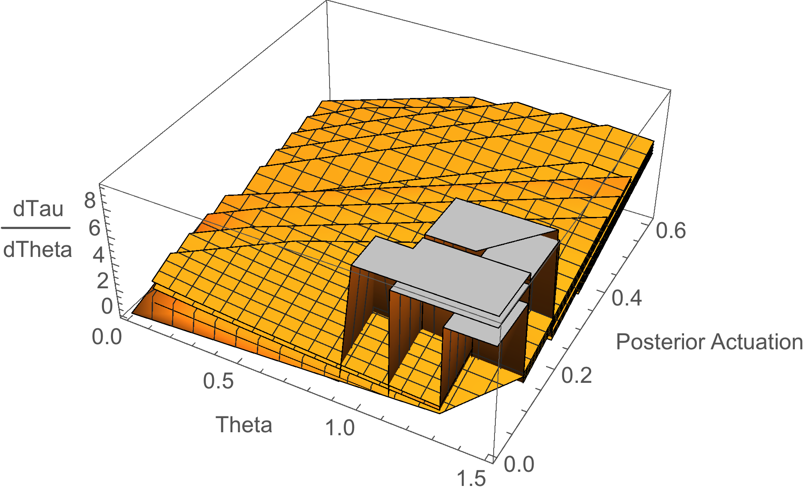
Muscle Activation Mapping Results
Different surfaces represent different load values

Slide 11
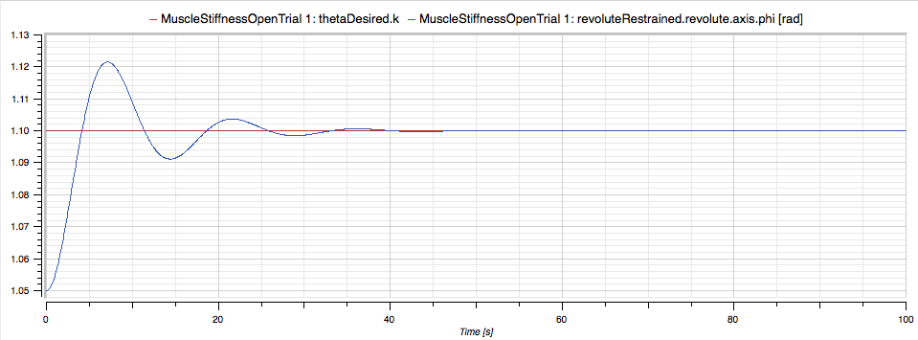
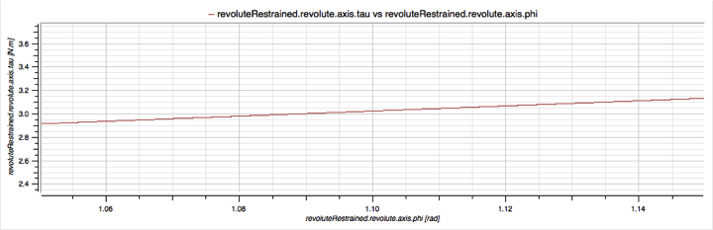
Validation of Approach
Muscle actuation for desired theta and stiffness
Desired Angle: 1.1 rad Achieved Angle: 1.1 rad
Desired Stiffness: 2.19318 Nm/rad Achieved Stiffness: 2.19228

Slide 12
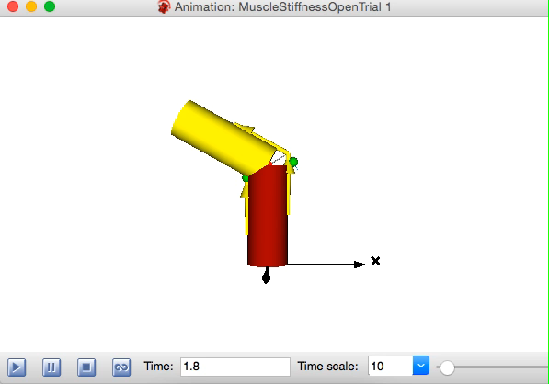

Slide 13
Conclusion
I successfully mapped the relationship between the angle of contraction, the load, the effective stiffness, and the muscle actuation values.
I can now use this mapping to control the joint movement to achieve the desired output.
From the results the primary question of the project is answered:
Mathematical model based analysis be used to describe the musculoskeletal dynamics of the hand

Slide 14
Further Work
I will increase the scope of the model from the functional unit model to a full-scale hand model
After completing this, I can then begin to integrate this understanding into building a prototype

